Slide 1
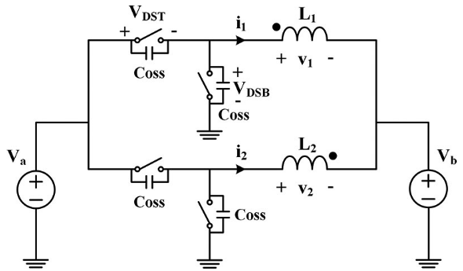
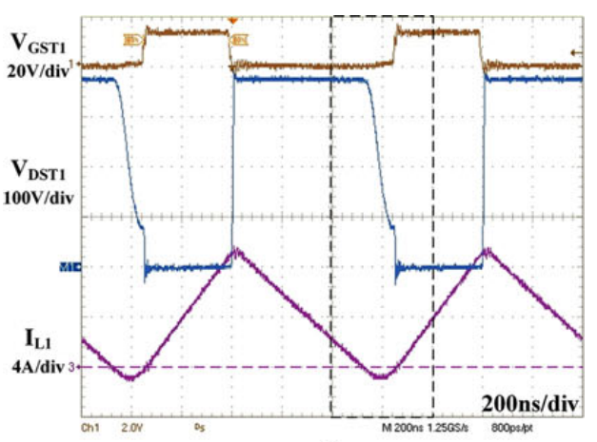
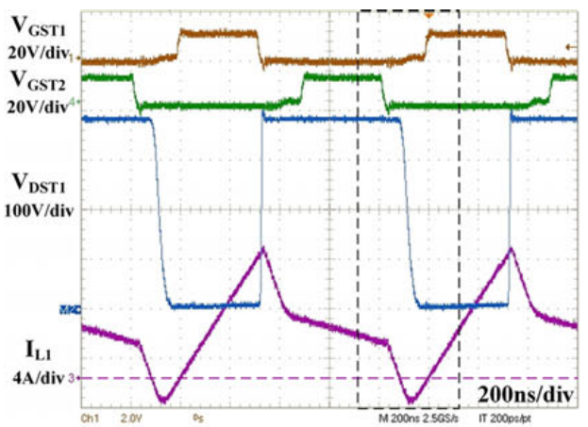
Inductor Design
Individual inductors for each phase
Coupled inductor for two phases
Individual Inductor
Coupled Inductor

Slide 2
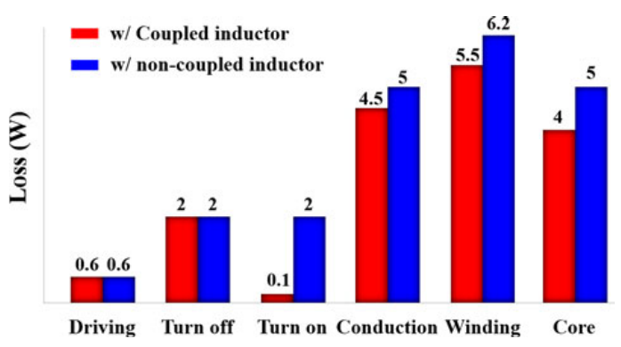
Inductor Design
5W losses for full load operation (8A) at 1 MHz switching frequency
Coupled cores are advantageous for
Shorter resonant period
Lower core losses
Lower current ripple
but
Requires complex design
«Core loss is also reduced with coupled inductor since core volume can be shrink due to certain dc flux cancellation»

Slide 3
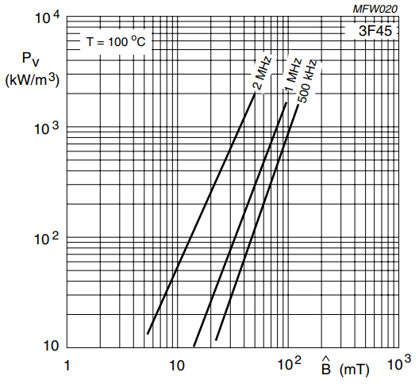
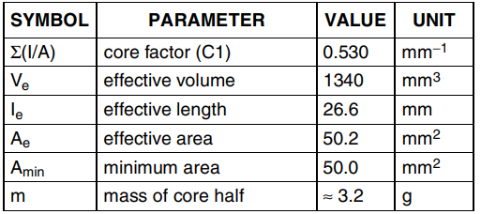
Lets verify it
Non-coupled inductor material
ER23 core with 3F45 material from Ferroxcube
AL -> 1850 nH
μr -> 840
Effective core parameters
Specific power loss of 3F45 material

Slide 4
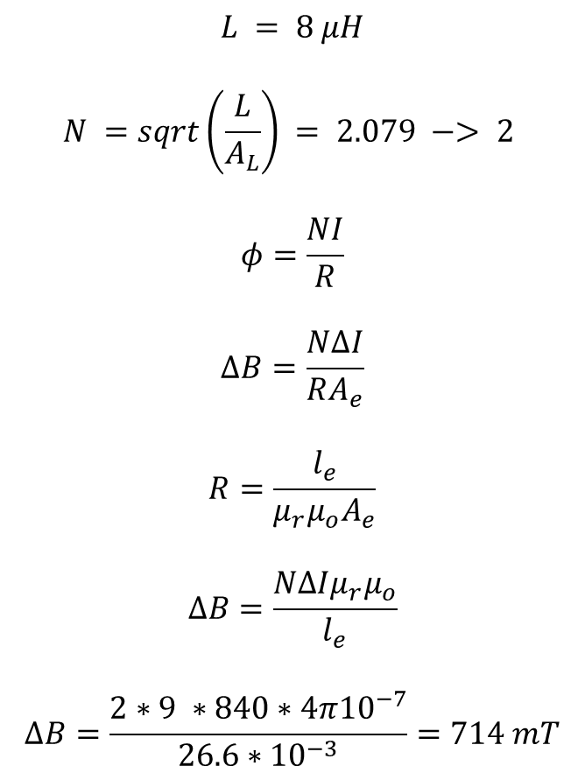
Lets verify it
$$L = 8 μH$$
$$N =sqrt\left(\frac{L}{A_{L}}\right) = 2.079 −> 2$$
$$φ=\frac{NI}{R}$$
$$ΔB=\frac{NΔI}{RA_{e}}$$
$$R=\frac{l_{e}}{{μ_{r}μ}_{o}A_{e}}$$
$$ΔB=\frac{NΔI{μ_{r}μ}_{o}}{l_{e}}$$
$$ΔB=\frac{2∗9 ∗840∗4π{10}^{−7}}{26.6∗{10}^{−3}}=714 mT$$
Current Waveform
5Arms current with 4A average
9App ripple on inductor

Slide 5

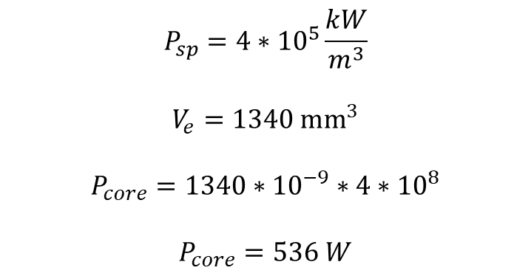
Lets verify it
$$P_{sp}=4∗{10}^{5}\frac{kW}{m^{3}}$$
$$V_{e}=1340 {mm}^{3}$$
$$P_{core}=1340∗{10}^{−9}∗4∗{10}^{8}$$
$$P_{core}=536 W$$
40x

